Slide 1
General and Analytical Chemistry I CHMG-141 with Dr. Bailey Review Session (Final Exam)

Slide 2
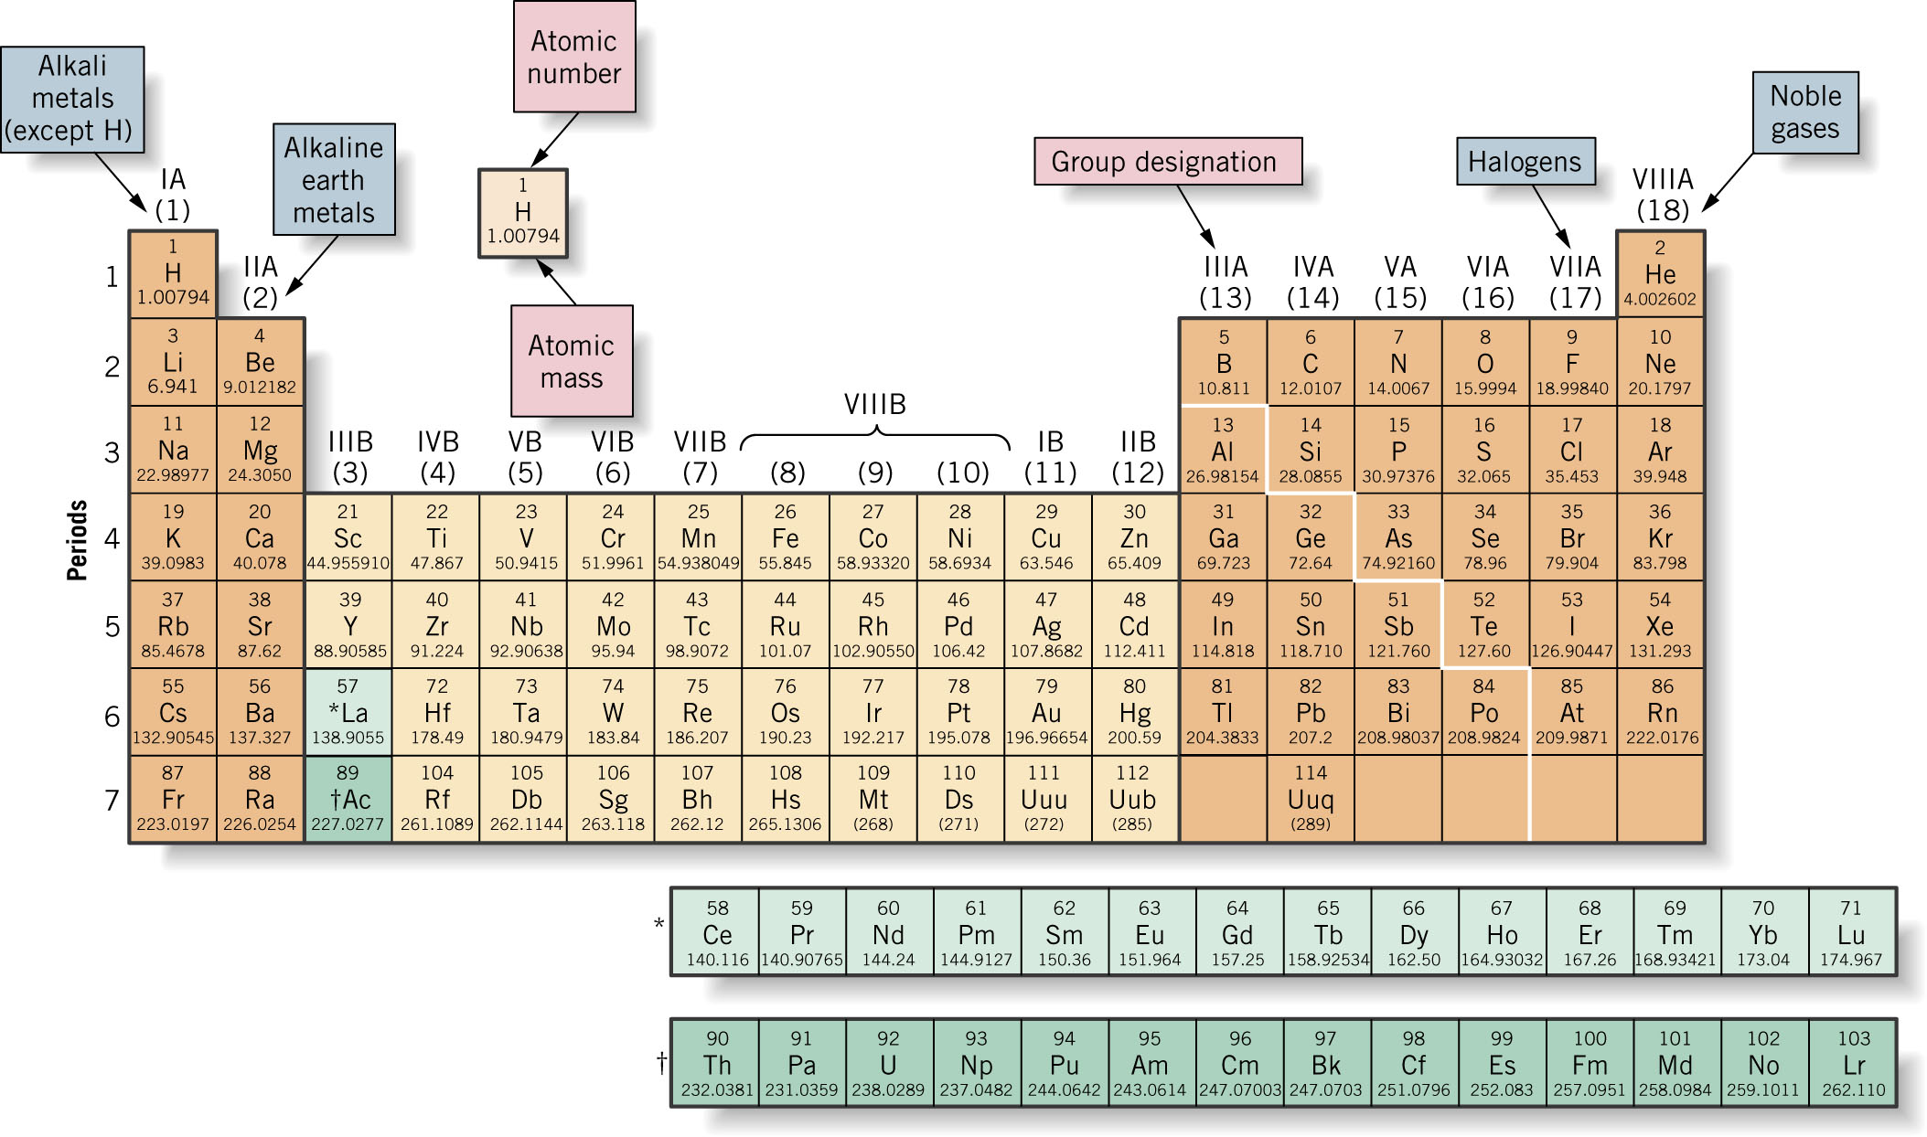

Slide 3
The Periodic Table Metals (main groups, transition) Nonmetals Metalloids

Slide 4
Electron configuration
Atoms
Ions
Valence electrons

Slide 5
Arrangement of Electrons in Atoms
Electrons in atoms are arranged as
SHELLS (n)
SUBSHELLS (l)
ORBITALS (m_{l})
Orbitals grouped in s, p, d (and f) subshells

Slide 6
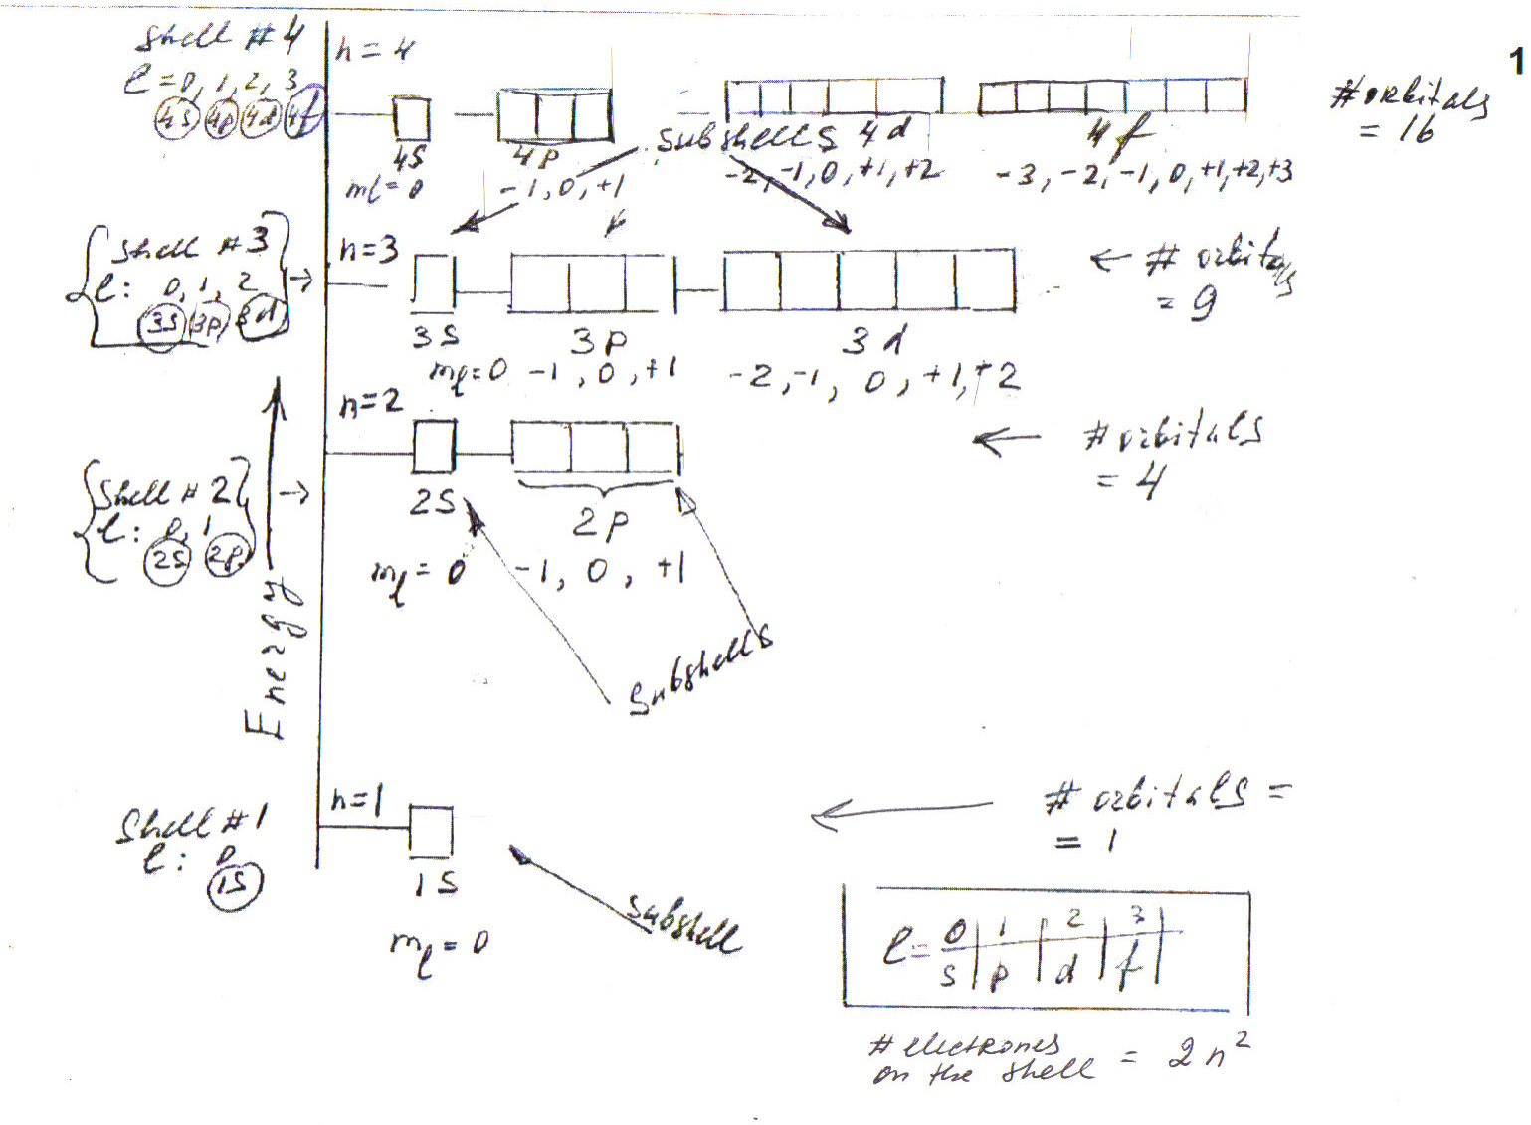

Slide 7
Periodicity
Size of Atoms
Ionization Energy
Effinity

Slide 8
Isotopes
Atoms of the same element (same Z) but different mass number (A).
Boron-10 (¹⁰B) has 5 p and 5 n: ¹⁰₅B
Boron-11 (¹¹B) has 5 p and 6 n: ¹¹₅B
¹¹B
¹⁰B

Slide 9
Element (atoms, isotopes, ions) Compound Mixture: - Heterogeneous - Homogeneous (Solutions)

Slide 10
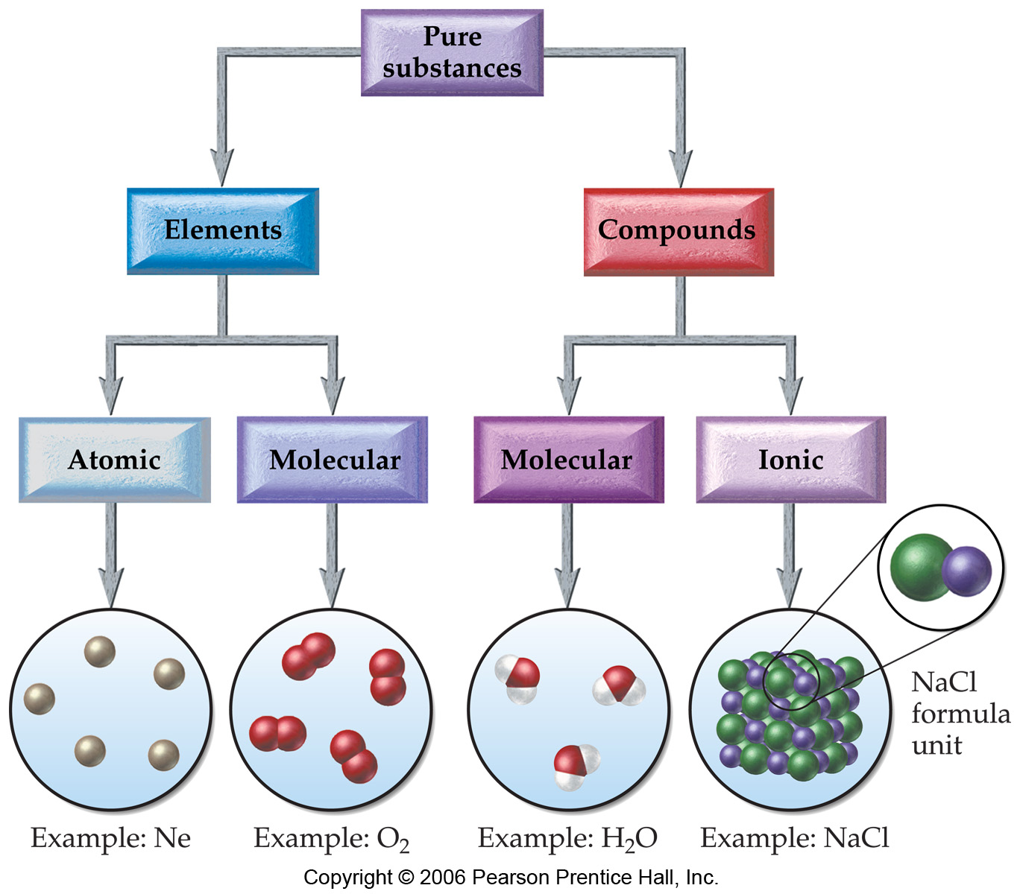

Molecular View of Elements and Compounds
Ionic Compounds:
Metals + nonmetals.
Molecular Compounds:
Two or more nonmetals.

Slide 11
How each of the following can be classified…
The mixture of gases in a SCUBA diving tank
A coin made from nickel and copper
Spring water purchased at a supermarket
Gasoline in a car
He
Cl₂
NH₃ (aq)
Hot dog
CaSO₄

Slide 12
Compound Composition (%, molar) Type - Ionic - Molecular

Slide 13
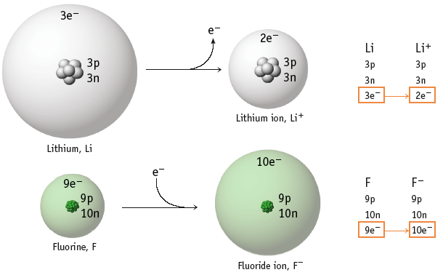
Active figure 3.5

Slide 14
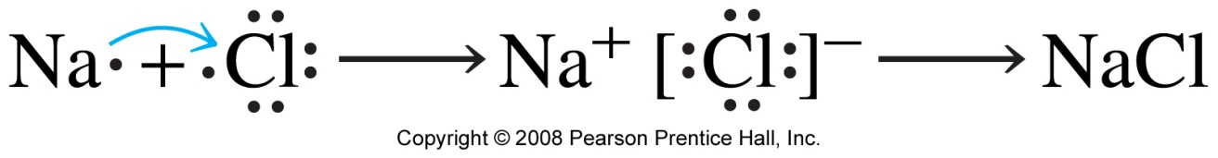
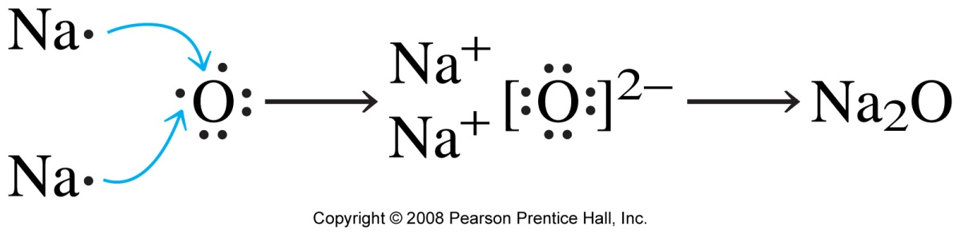
Bonding in Ionic Compounds

Slide 15
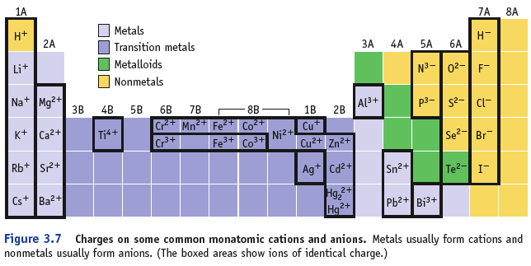
Predicting Charges on Monatomic Ions

Slide 16
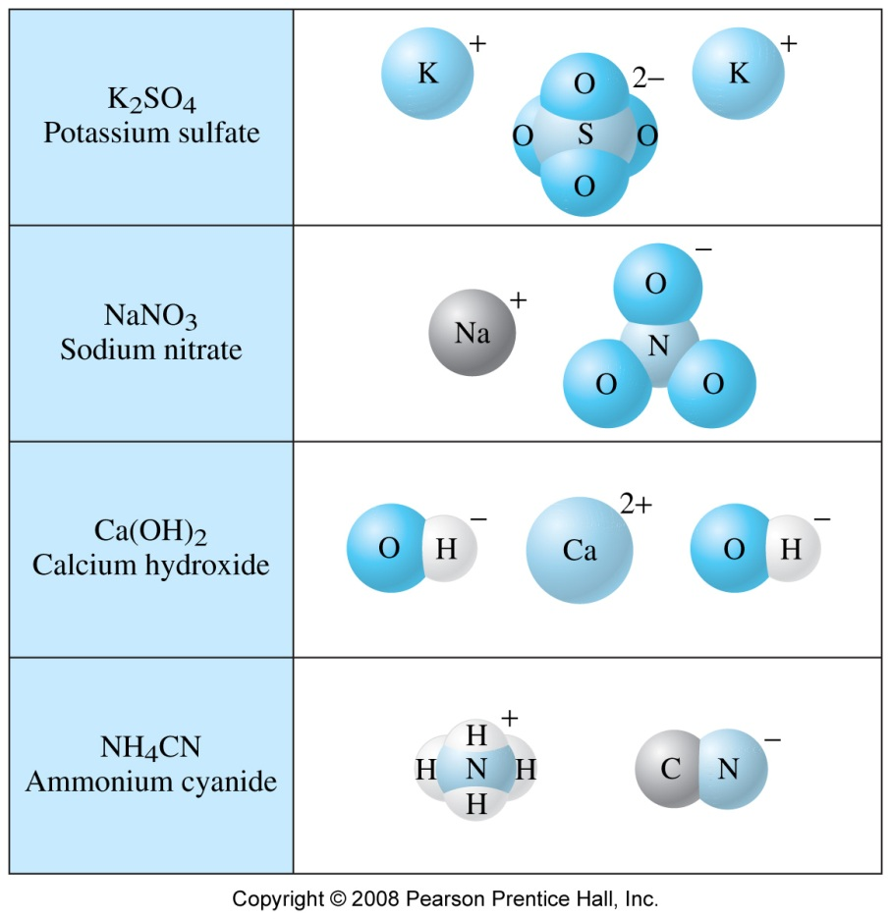
Compounds Containing Polyatomic Ions
Polyatomic ions are single ions that contain more than one atom
Name and charge of polyatomic ion do not change
Name any ionic compound by naming cation first and then anion

Slide 17
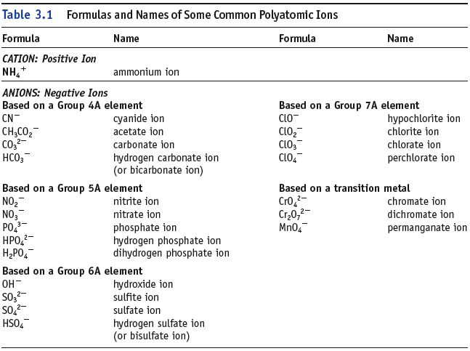
Note: many O containing anions have names ending in –ate (or -ite).

Slide 18
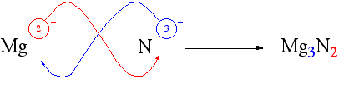
Writing Formulas
A neutral compd.
requires
equal number of +
and - charges.
Rules for writing Formulas of Ionic Compounds:
The charge on the cation becomes the subscript on the anion.
The charge on the anion becomes the subscript on the cation.
The positive ion is given first in the formula.
The subscripts in the formula must produce an electrically neutral formula unit.
The subscripts should be the set of smallest whole numbers possible. If these subscripts are not in the lowest whole-number ratio, divide them by the greatest common factor.
The charges on the ions are not included in the finished formula of the substance.
2009, Prentice-Hall, Inc.
Notes:
18

Slide 19
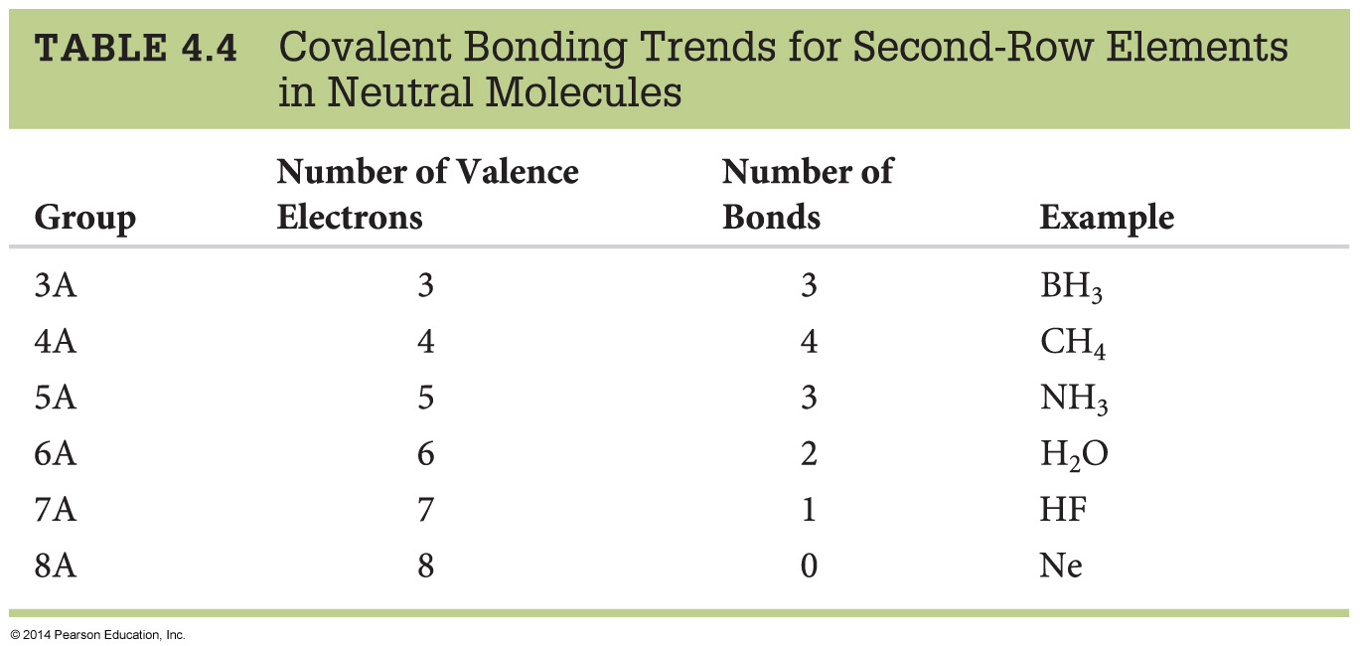
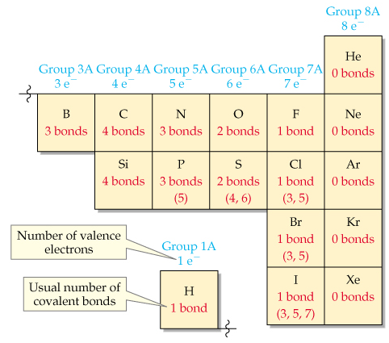
Covalent Bonds and the Periodic Table

Slide 20
Structure
Geometry
Polarity
Properties (Physical state changes…)

Slide 21
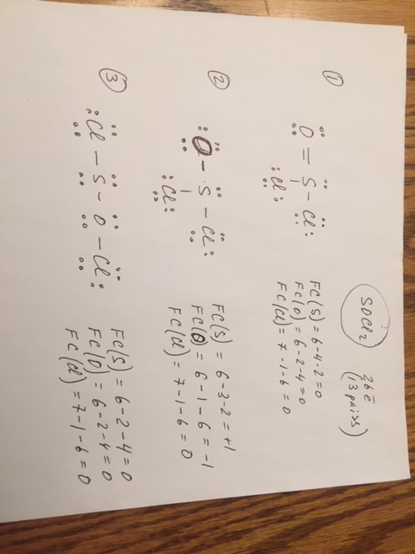
#1 and #2 are the resonance structures;
The connection between atoms remains the same
Differ only in placement of the valence electrons
Geometry is the same
Which is better?

Slide 22
Rules of Resonance Structures
In Summary:
Resonance structures must have the same connectivity
only electron positions can change
Resonance structures must have the same number of electrons
Second row elements have a maximum of 8 electrons
bonding and nonbonding
third row can have expanded octet
Better structures have fewer formal charges
Better structures have smaller formal charges
Better structures have (−) formal charge on more electronegative atom

Slide 23
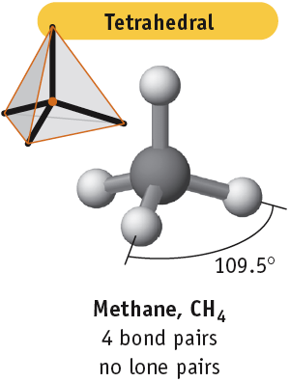
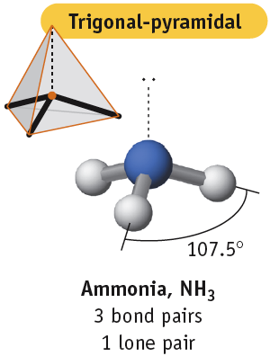
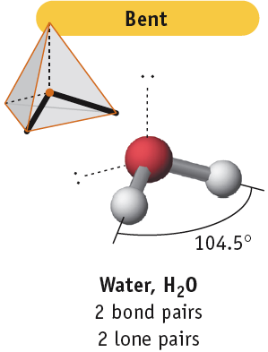
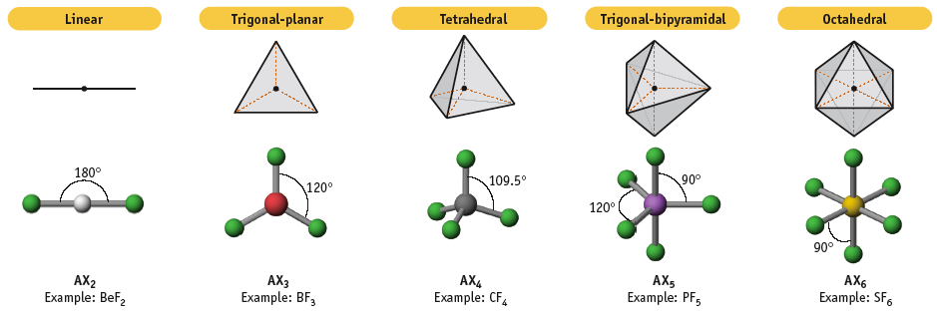
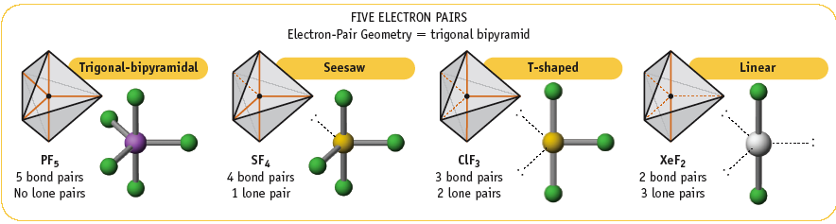
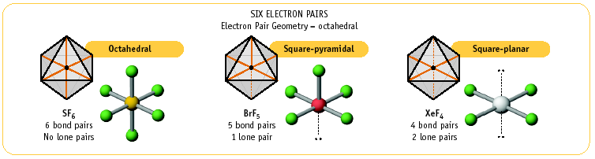

Slide 24
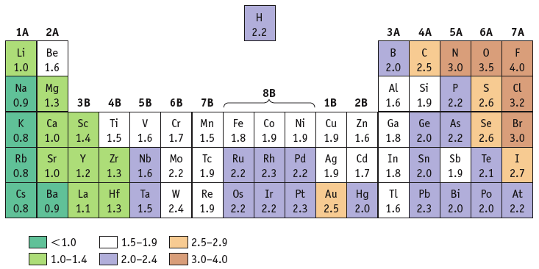
Electronegativity
Recall…
is a measure of the ability of an atom in a molecule to attract electrons to itself. Concept proposed by Linus Pauling 1901-1994

Slide 25
Electronegativity and Bond Polarity
If difference in electronegativity between bonded atoms is 0, the bond is pure covalent
equal sharing
If difference in electronegativity between bonded atoms is 0.1 to 0.4, the bond is nonpolar covalent
If difference in electronegativity between bonded atoms 0.5 to 1.9, the bond is polar covalent
If difference in electronegativity between bonded atoms larger than or equal to 2.0, the bond is ionic

Slide 26
The first law of thermodynamics Internal Energy of Molecules Heat of Reactions and Heat transfer

Slide 27
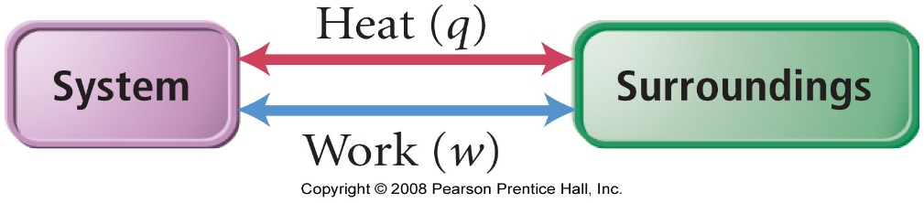
How Is Energy Exchanged?
Energy is exchanged between the system and surroundings through heat and work
q = heat (thermal) energy
w = work energy
According to the first law of thermodynamics, the change in the internal energy of the system (ΔE) must be the sum of the heat transferred (q) and the work done
ΔE = q + w
q (heat) | system gains heat energy + | system releases heat energy ─
w (work) | system gains energy from work + | system releases energy by doing work ─
ΔE | system gains energy + | system releases energy ─
Example..

Slide 28
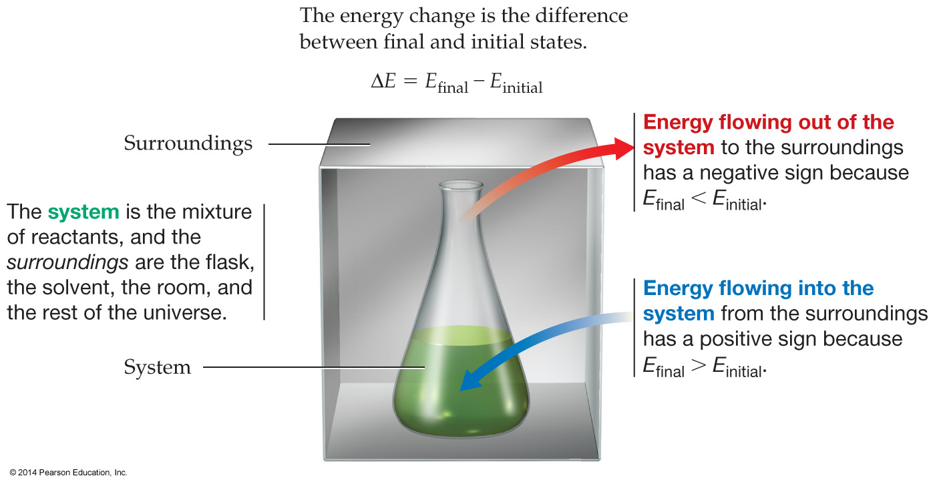
Internal Energy of Molecules: State Functions
Example:
∆E = E_{final} - E_{initial}
Example…
Notes:
Restating the first law.

Slide 29
Internal Energy of Molecules:
State Functions
Example:
CH₄(g) + 2 O₂(g)
CO₂(g) + 2 H₂O(g) + 802 kJ energy
∆H = -802 kJ
∆E = E_{final} - E_{initial} = -802 kJ
802 kJ is released when 1 mole of methane, CH₄, reacts with 2 moles of oxygen to produce 1 mole of carbon dioxide and 2 moles of water.
Just as energy comes in many forms,
so too does work …

Slide 30
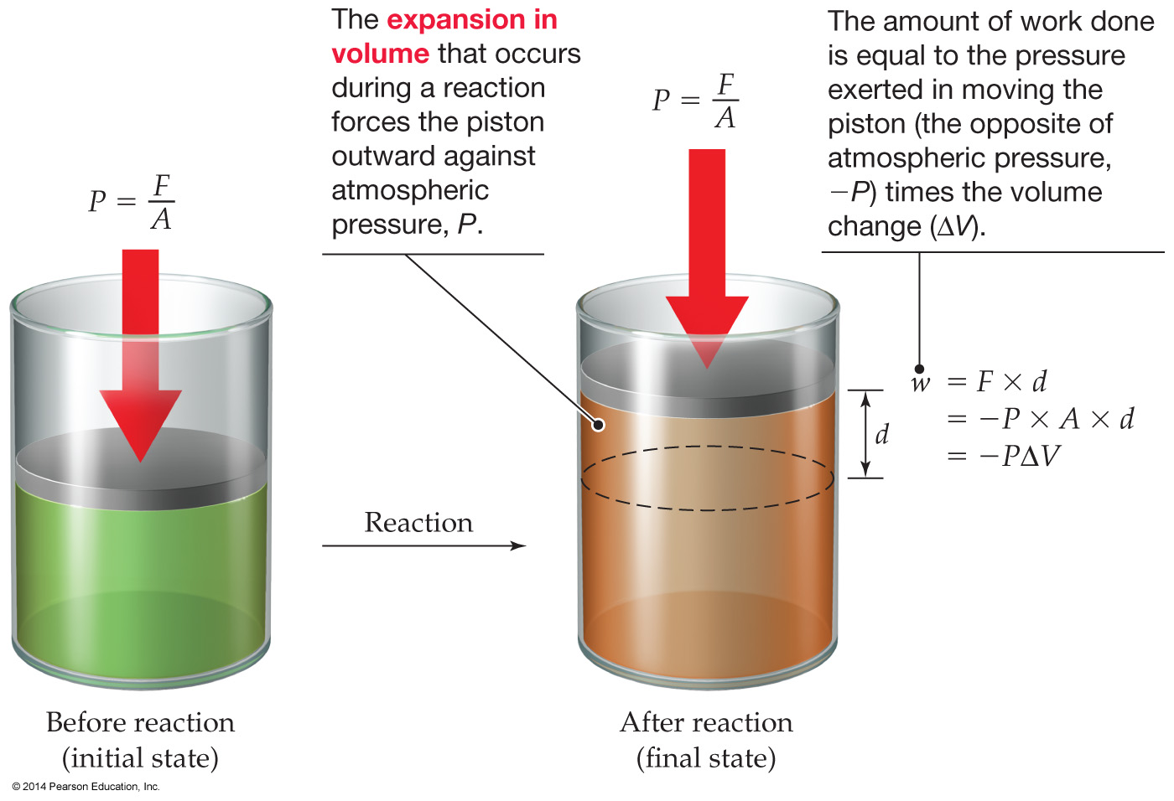
Expansion Work Done by Reactions
Just as energy comes in many forms,
so too does work .
The most common type of work in chemical system is the expansion work: Work done as the result of a volume change in the system.
Also called pressure-volume, or PV, work.
Work = Force x Distance
w = F x d

Slide 31
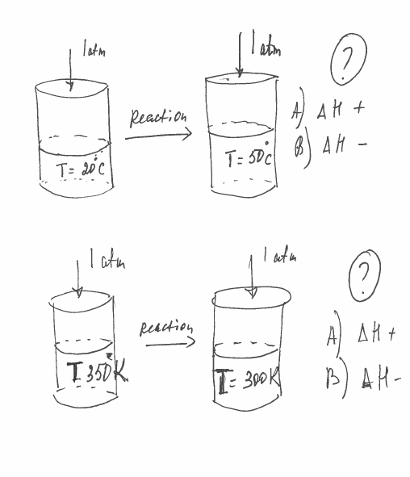

Slide 32
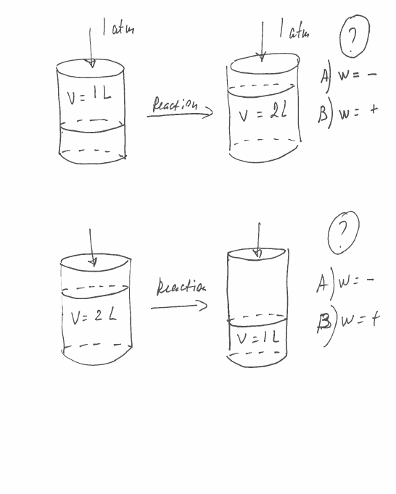

Slide 33
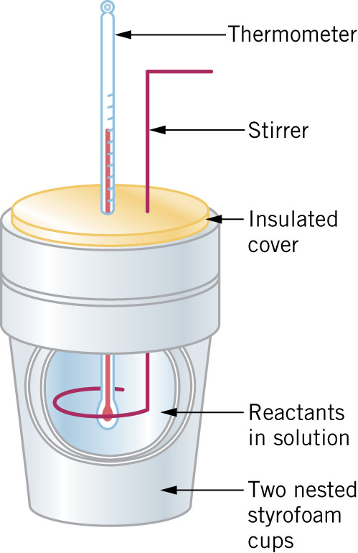
CALORIMETRY
A coffee cup calorimeter can be used to measure heats of reaction at constant pressure.
Heat can be released or absorbed, resulting in a change in temperature of the solution.
Amount of heat that a reaction produces or absorbs depends on the number of moles of reactant that react

Slide 34
In Summary…
Hess’s Law
Enthalpy changes for reactions can be calculated by algebraic summation
This is called Hess’s Law:
The value of ΔH for any reaction that can be written in steps equals the sum of the values of ΔH for each of the individual steps.
Enthalpy changes may be calculated using only a few simple rules…

Slide 35
An example…
1
½ N₂ (g) + O₂ (g) → NO₂ (g) ΔHº = +33.8 kJ
½ N₂ (g) + ½ O₂ (g) → NO (g) ΔHº = +90.37 kJ
NO(g) + ½ O₂ (g) → NO₂ (g) ΔHº = ?
Alternatively...
½ N₂ (g) + O₂ (g) → NO₂ (g) ΔHº = +33.8 kJ
NO (g) → ½ N₂ (g) + ½ O₂ (g) ΔHº = -90.37 kJ
NO(g) + O₂ (g) + ½ N₂ (g) → NO₂ (g) + ½ N₂ (g) + ½ O₂ (g)
ΔHº = ?
NO(g) + ½ O₂ (g) → NO₂ (g) ΔHº = 1-2 = -56.6 kJ
2
1
-2
½

Slide 36
Using Hess’ Law
CH₃OH(g) + 3/2 O₂(g) --> CO₂(g) + 2 H₂O(g)
∆Hº_{rxn} = Σ ∆H_{f}º (prod) - Σ ∆H_{f}º (react)
∆Hº_{rxn} = ∆H_{f}º (CO₂) + 2 ∆H_{f}º (H₂O)
- {3/2 ∆H_{f}º (O₂) + ∆H_{f}º (CH₃OH)}
= (-393.5 kJ) + 2 (-241.8 kJ)
- {0 + (-201.5 kJ)}
∆Hº_{rxn} = -675.6 kJ per mol of methanol

Slide 37
3.The standard enthalpy of formation of a substance is the amount of heat absorbed when 1 mole of the substance if formed at 25 °C and 1 atm from its elements in their standard states
The standard enthalpy of formation for elements in their standard states are zero
These are the values most commonly used to calculated standard enthalpy changes for reactions…
Hess’ Law restated…

Slide 38
Which equation below defines the standard molar enthalpy of formation of gaseous methanol CH₃OH?
10
CH₄(g) + 1/2 O₂(g) → CH₃OH(g)
C(s) + 2 H₂(g) + 1/2 O₂(g) → CH₃OH(g)
CO(g) + 2 H₂(g) → CH₃OH(g)
H₂O(g) + C(s) + H₂(g) → CH₃OH(g)

Slide 39
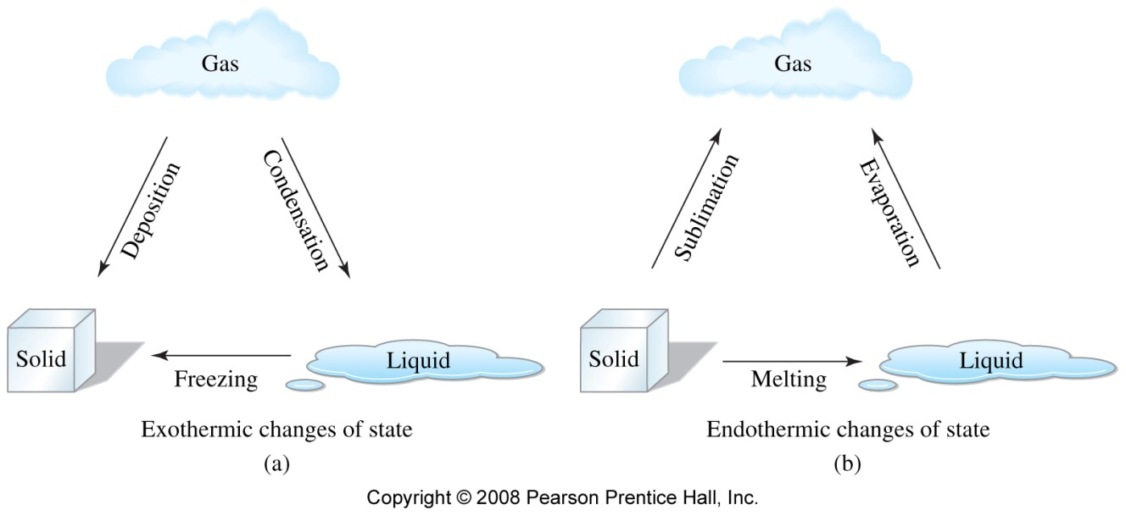
Changes of state

Slide 40
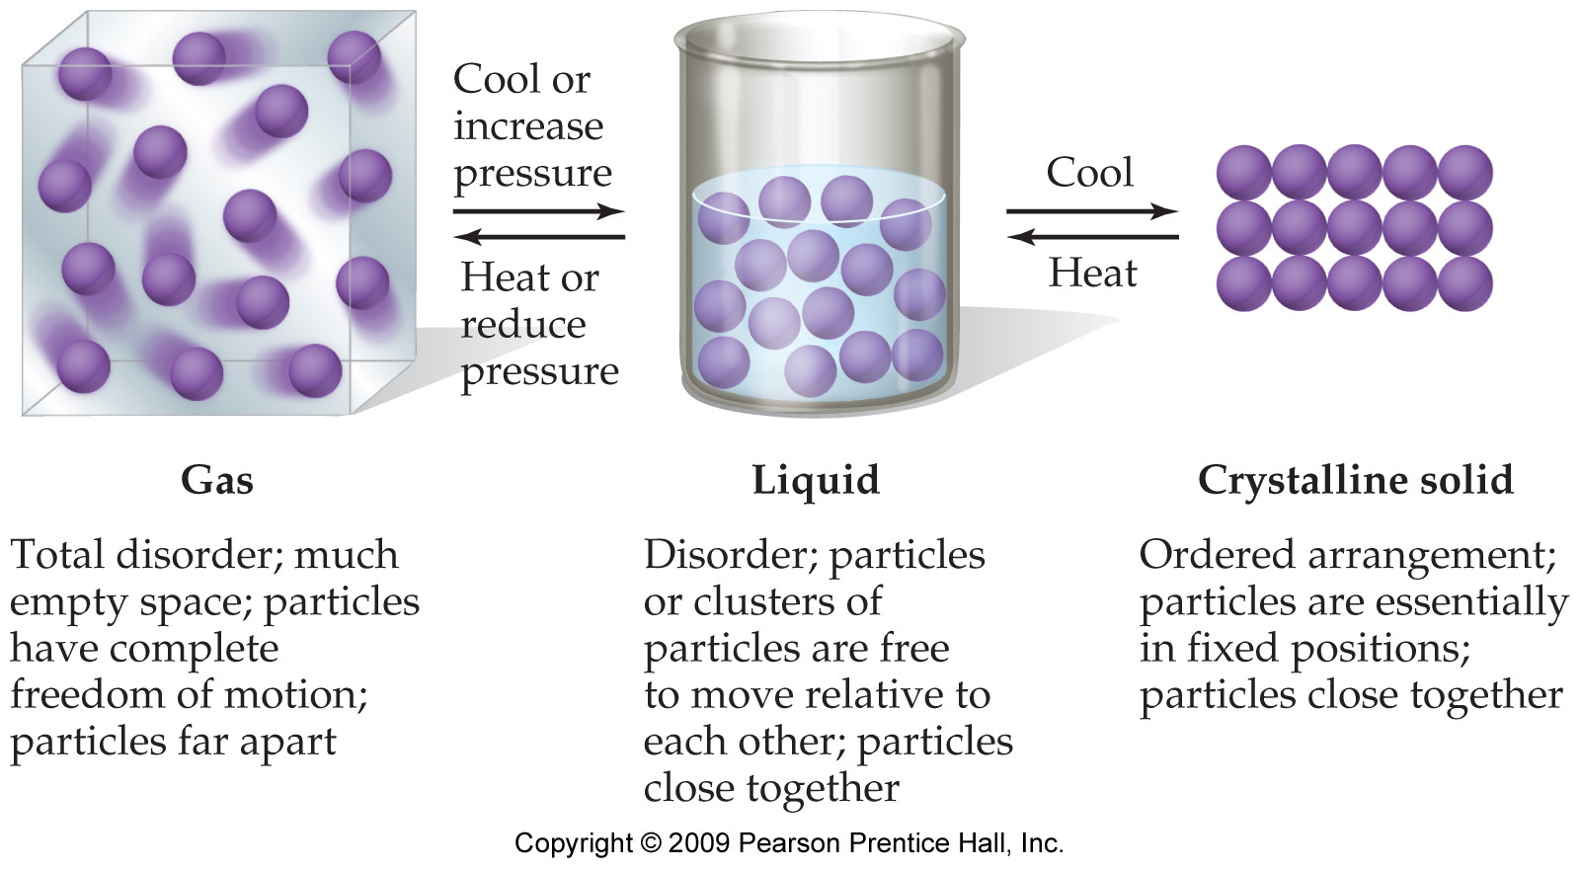
States of Matter Matter can exist in any of three phases, or states- solid, liquid, and gas depending on the strength of the attractive forces among the particles in the substance.
Notes:
40

Slide 41
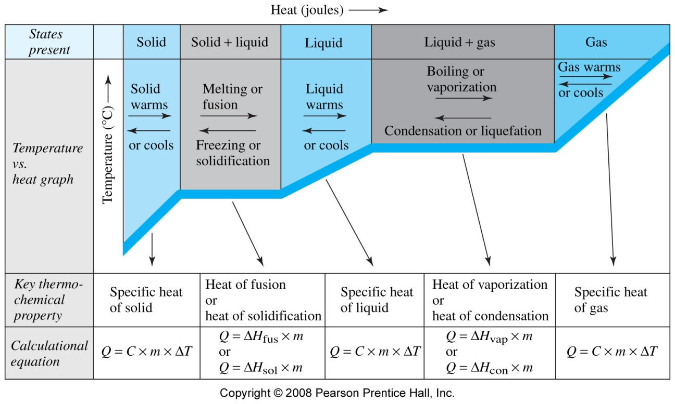
Heating Curve of Water
5
4
3
2
1
(or n)
(or n)
m – mass, g
n – number of moles
ΔH_{fus}
J/g or J/mol
ΔH_{vap}

Slide 42
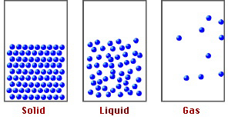
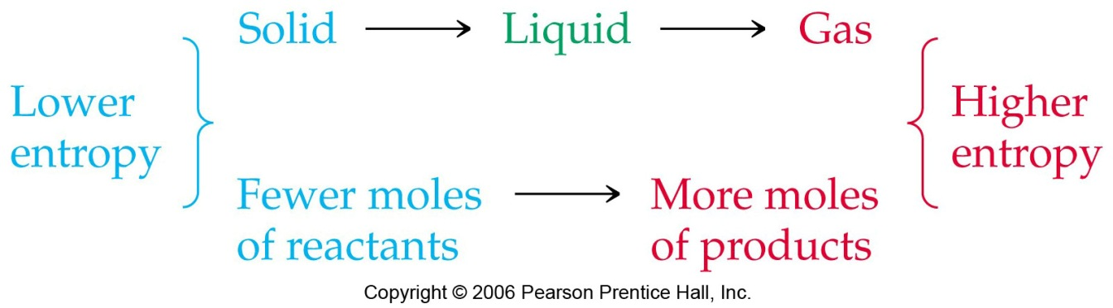
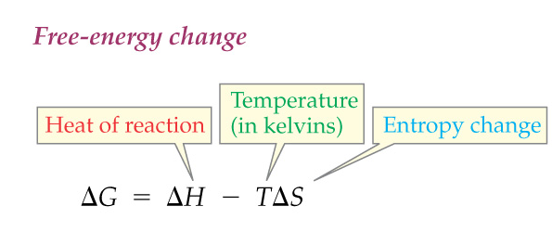
Increases in Entropy Example
The greater the disorder or randomness of the particles in a substance or mixture, the larger the value of S.
4 NH_{3(g)} + 5 O_{2(g)} → 4 NO_{(g)} + 6 H₂O_{(g)}

Slide 43
Electrolytes in Aqueous Solution
Electrolytes: Substances that dissolve in water to produce conducting solutions of ions.
H₂O
NaCl(s)
Na⁺(aq) + Cl–(aq)
Nonelectrolytes: Substances that do not produce ions in aqueous solutions.
H₂O
C₁₂H₂₂O₁₁(s)
C₁₂H₂₂O₁₁(aq)
Dissociation Equations (More examples)…

Slide 44
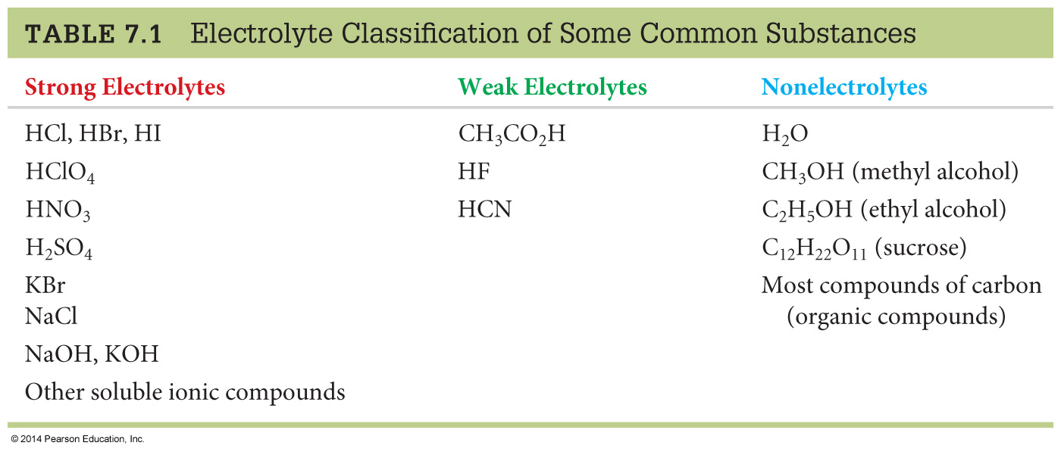
Electrolytes in Aqueous Solution
Strong Acids: Hydrochloric acid, hydrobromic acid, hydroiodic acid, perchloric acid, nitric acid, sulfuric acid.
Notes:
Strong acids are strong electrolytes (which is why they are called strong acids!). These are typically called the 6 common strong acids. There are other strong acids.

Slide 45
Electrolytes in Aqueous Solution
Ionic compounds

Slide 46
Chemical Change (Chemical Reactions) Type of Chemical Reactions - Precipitation (solubility rule) - Neutralization (acid, base, titration) - Gas forming - Ox-Red (oxidation numbers)

Slide 47
Further Classification
EXCHANGE: Precipitation Reactions
EXCHANGE
Gas-Forming
Reactions
EXCHANGE
Acid-Base
Reactions
REACTIONS
REDOX REACTIONS

Slide 48
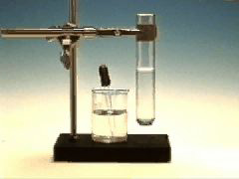
Chemical Reactions in Water
We will look at EXCHANGE REACTIONS
Pb(NO₃) ₂(aq) + 2 KI(aq)
→ PbI₂(s) + 2 KNO₃ (aq)
The anions exchange places between cations.
So…

Slide 49
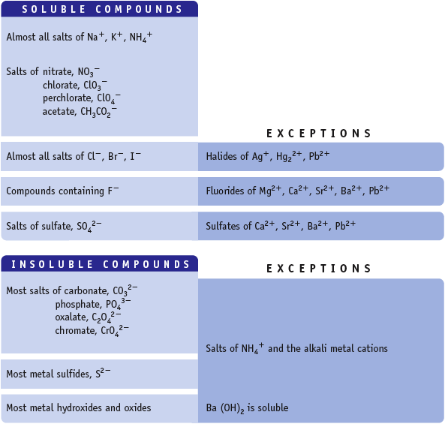
Water Solubility of Ionic Compounds
If one ion from the “Soluble Compd.” list is present in a compound, the compound is water soluble.

Slide 50
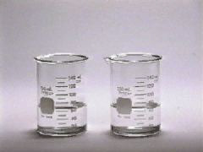
Acid-Base Reactions
The “driving force” is the formation of water.
NaOH(aq) + HCl(aq) →
NaCl(aq) + H₂O(liq)
Net ionic equation
OH⁻(aq) + H⁺(aq) → H₂O(liq)
This applies to ALL reactions of STRONG acids and bases.

Slide 51
Acid-Base Reactions
A-B reactions are sometimes called NEUTRALIZATIONS because the solution is neither acidic nor basic at the end.
The other product of the A-B reaction is a SALT, MX.
HX + MOH ---> MX + H₂O
M^{n+} comes from base & X^{n-} comes from acid
This is one way to make compounds!

Slide 52

Oxidation: Loss of Electrons by a reactant is Oxidation
Reduction: Gain of Electrons by a reactant is Reduction
Remember! LEO the lion says GER!
Na → Na⁺ + e⁻ (oxidation)
Cl₂ + 2e⁻ → 2Cl⁻ (reduction)
Let’s look at the details…

Slide 53
Oxidations and Reductions always occur together!!!
While one species is losing the electrons, another species in the equation is gaining them!
2Ca_{(s)} + O_{2(g)} 2CaO_{(s)}
Calcium is losing electrons Calcium is oxidized
Oxygen is gaining electrons Oxygen is reduced
Therefore it can be said that:
Calcium is the Reducing Agent
Oxygen is the Oxidizing reagent
Periodic Table…

Slide 54
Identify the Oxidizing and Reducing Agents in Each of the Following
3 H₂S + 2 NO₃– + 2 H⁺ → 3 S + 2 NO + 4 H₂O
MnO₂ + 4 HBr → MnBr₂ + Br₂ + 2 H₂O

Slide 55
Identify the Oxidizing and Reducing Agents in Each of the Following
red ag
ox ag
3 H₂S + 2 NO₃– + 2 H⁺ → 3 S + 2 NO + 4 H₂O
MnO₂ + 4 HBr → MnBr₂ + Br₂ + 2 H₂O
+1 -2 +5 -2 +1 0 +2 -2 +1 -2
oxidation
reduction
ox ag
red ag
+4 -2 +1 -1 +2 -1 0 +1 -2
oxidation occurs when an atom’s oxidation state increases during a reaction
reduction occurs when an atom’s oxidation state decreases during a reaction
oxidation
reduction

Slide 56
Stoichiometry
Balancing of Equation
Calculations /moles, g, Molarity, n(gases)/
Thermochemical Equation

Slide 57
PROBLEM: What amount of Mg (number of moles) is represented by 0.200 g? How many atoms?
Mole!!!
Mg has a molar mass of 24.3050 g/mol.
How many atoms in this piece of Mg?
= 4.95 x 10²¹ atoms Mg

Slide 58
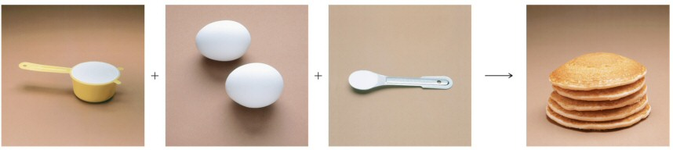
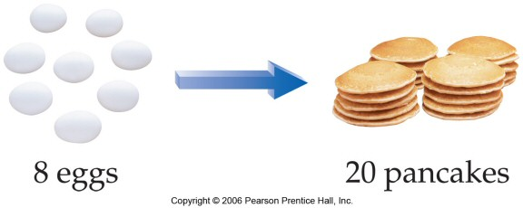
Making Pancakes
The number of pancakes you can make depends on the amount of the ingredients you use.
1 cup flour + 2 eggs + ½ tsp baking powder → 5 pancakes
1 cup flour ≡ 2 eggs ≡ ½ tsp baking powder ≡ 5 pancakes

Slide 59
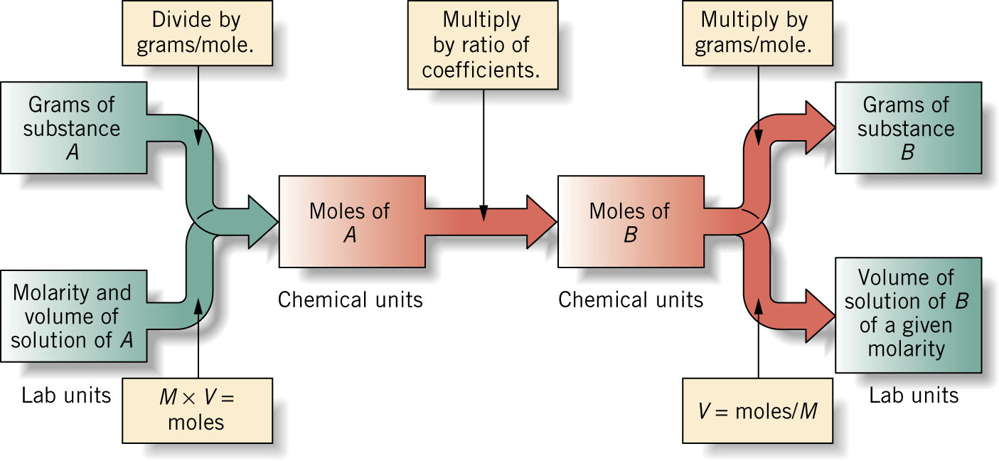
Reactions Involving Gases
Using PV = nRT
P, V, T of Gas A
mole A
mole B
P, V, T of Gas B

Slide 60
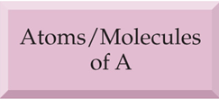
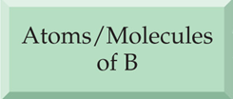
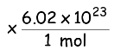
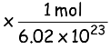
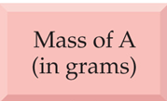
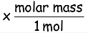
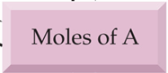
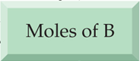
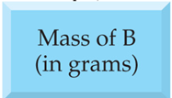
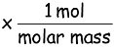
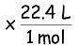

Mole Conversions to Mass, Volume, Molecules, and Molarity
Convert using
Avagadro’s Number
Convert using
Coefficients
Convert using
Molar Mass
(g/mol) or use (mol/g)
Convert using
Gas Law
Molarity
Volume of A
Volume of B
Molarity

Slide 61
See the recitation W15 “Stoichiometry Review”

Slide 62
Stoichiometric Relationships with Gases
One more example:
The reaction used in the deployment of automobile airbags is the high-temperature decomposition of sodium azide, NaN₃, to produce N₂ gas.
How many liters of N₂ at 1.15 atm and 30.0 °C are produced by decomposition of 45.0 g NaN₃?
2 NaN₃(s)
2 Na(s) + 3 N₂(g)

Slide 63
Stoichiometric Relationships with Gases
2 NaN₃(s)
2 Na(s) + 3 N₂(g)
Moles of N₂ produced:
1 mol NaN₃
3 mol N₂
45.0 g NaN₃
x
x
= 1.04 mol N₂
65.0 g NaN₃
2 mol NaN₃
Volume of N₂ produced:
L atm
(1.04 mol)
0.082 058
(303.2 K)
nRT
K mol
V =
=
= 22.5 L
P
(1.15 atm)

Slide 64

Example– What volume of 0.150 M KCl is required to completely react with 0.150 L of 0.175 M Pb(NO₃)₂ in the reaction 2 KCl(aq) + Pb(NO₃)₂(aq) → PbCl₂(s) + 2 KNO₃(aq)
Sort Information
Given:
Find:
0.150 M KCl, 0.150 L of 0.175 M Pb(NO₃)₂
L KCl
Strategize
Concept Plan:
Relationships:
1 L Pb(NO₃)₂ = 0.175 mol, 1 L KCl = 0.150 mol,
1 mol Pb(NO₃)₂ = 2 mol KCl
L Pb(NO₃)₂
mol Pb(NO₃)₂
mol KCl
L KCl
Follow the Concept Plan to Solve the problem
Solution:
Check
Check:
since need 2x moles of KCl as Pb(NO₃)_{2,} and the molarity of Pb(NO₃)₂ > KCl, the volume of KCl should be more than 2x volume Pb(NO₃)₂

Slide 65
Gases (See Exam 3 KEY)

Slide 66

Electromagnetic Spectrum
visible light comprises only a small fraction of all the wavelengths of light –
called the electromagnetic spectrum
short wavelength (high frequency) light has high energy
radiowave light has the lowest energy
gamma ray light has the highest energy

Slide 67
Example 7.2- Calculate the number of photons in a laser pulse with wavelength 337 nm and total energy 3.83 mJ
Given:
Find:
λ = 337 nm, E_{pulse} = 3.83 mJ
number of photons
Concept Plan:
Relationships:
E=hc/λ, 1 nm = 10⁻⁹ m, 1 mJ = 10⁻³ J, E_{pulse}/E_{photon} = # photons
λ(nm)
λ (m)
E_{photon}
number
photons
Solve:

